Slide 1
TDSRC 2025 TRIVIA GAME
SNAPSHOT

Slide 2
HERE’S HOW IT WORKS
Each question will test your knowledge of a landmark, location or item from around the world.
All you have to go on is a description and a snapshot image!
Can you identify them all?
For an added challenge, click the one-minute timer video with each question
to see how fast you can answer!
GOOD LUCK & BON VOYAGE!

Slide 3
SCOREBOARD
Enjoy a little friendly competition? Print and keep track of your points here
TEAM ONE
TEAM TWO

Slide 4
READY?

Slide 5
WHAT COUNTRY IS THIS IN?
this IS IN…
In addition to shrines like this, this country is also known for its unique comic and animation style—Pokémon, anyone?

Slide 6
WHAT COUNTRY IS THIS IN?
ANSWER
this IS IN…
JAPAN
The Fushimi Inari Shrine is an important Shinto shrine in southern Kyoto.

Slide 7
WHAT IS THE FORMAL NAME OF THIS STATUE?
THIS IS…
This iconic statue stands in New York Harbor. It was a gift to the United States from France.

Slide 8
WHAT IS THE FORMAL NAME OF THIS STATUE?
ANSWER
THIS IS…
LIBERTY ENLIGHTENING
THE WORLD
This statue has many nicknames, including “Lady Liberty.”

Slide 9
GUESS THE COUNTRY
THIS IS IN…
Although considered a pyramid, this definitely isn’t in Egypt.

Slide 10
GUESS THE COUNTRY
ANSWER
THIS IS IN…
MEXICO
This Mesoamerican pyramid, El Castillo (“the Castle”), is in the ancient Mayan city of Chichen Itza, one of the New Seven Wonders of the World.

Slide 11
GUESS THE CITY
THIS CITY IS…
This Canadian building, Habitat 67, was originally built as an experimental residential complex.

Slide 12
GUESS THE CITY
ANSWER
THIS CITY IS…
MONTRÉAL
Montréal’s Habitat 67 was designed to rethink city and suburban living. Each unit in the building had direct access and privacy, but also a rooftop garden. The architect, Moshe Safdie, would say, “For everyone a garden.”

Slide 13
WHAT IS THIS CALLED?
THIS IS…
This is a fruit, but you probably won’t have it sliced with bananas and strawberries.
In fact, it’s not usually eaten raw at all!

Slide 14
WHAT IS THIS CALLED?
ANSWER
THIS IS…
BREADFRUIT
Typically found in the South Pacific and other tropical areas, breadfruit is a starchy fruit that is usually roasted, baked, boiled or even dried into flour.

Slide 15
NAME THIS ICONIC BUILDING
THIS IS…
This is one of the New Seven Wonders of the World. It sits on the southern bank of the Yamuna River.

Slide 16
NAME THIS ICONIC BUILDING
ANSWER
THIS IS…
THE TAJ MAHAL
This white marble structure was built by the Mughal emperor Shah Jahan in honour of his beloved wife, Mumtaz. Talk about true love!

Slide 17
WHAT RIVER IS THIS?
IT IS THE…
This river runs 1,538 km from Jasper National Park to a lake that shares its name.

Slide 18
WHAT RIVER IS THIS?
ANSWER
IT IS THE…
ATHABASCA RIVER
This is the longest river in Alberta!
It has been an important hunting and fishing site for Tsek'ehne, Secwépemc, Ktunaxa, Salish, Stoney Nakoda, Cree, and Métis Peoples.

Slide 19
WHAT IS RAPA NUI?
IT IS…
This isolated island houses over 600 gigantic stone statues called moai (pronounced “moe-eye”).

Slide 20
WHAT IS RAPA NUI?
ANSWER
IT IS…
EASTER ISLAND
Also known as Rapa Nui or “Great Rapa,” Easter Island is possibly one of the loneliest places on earth, despite its rich Polynesian history.

Slide 21
YUMMY!
MUST BE…
This cold, creamy treat begins with whole milk and is quite dense, so it’s slow to melt.

Slide 22
YUMMY!
ANSWER
MUST BE…
GELATO
Nope—not your average ice cream! With more air absorbed in the churning process, and less butterfat, gelato tends to be more intensely flavoured. In some parts of Italy, it is not unusual to have gelato as part of breakfast!

Slide 23
TASTY TREATS
THIS IS…
Served at many special occasions, including weddings and family reunions, this traditional Chinese dish can come in various sizes and colours.

Slide 24
TASTY TREATS
ANSWER
THIS IS…
TANG YUAN
Tang yuan is a traditional Chinese dish with a delicate and soft texture. Made from glutinous rice, it can be either sweet or savoury. It is often served at the Dongzhi (winter solstice) festival.

Slide 25
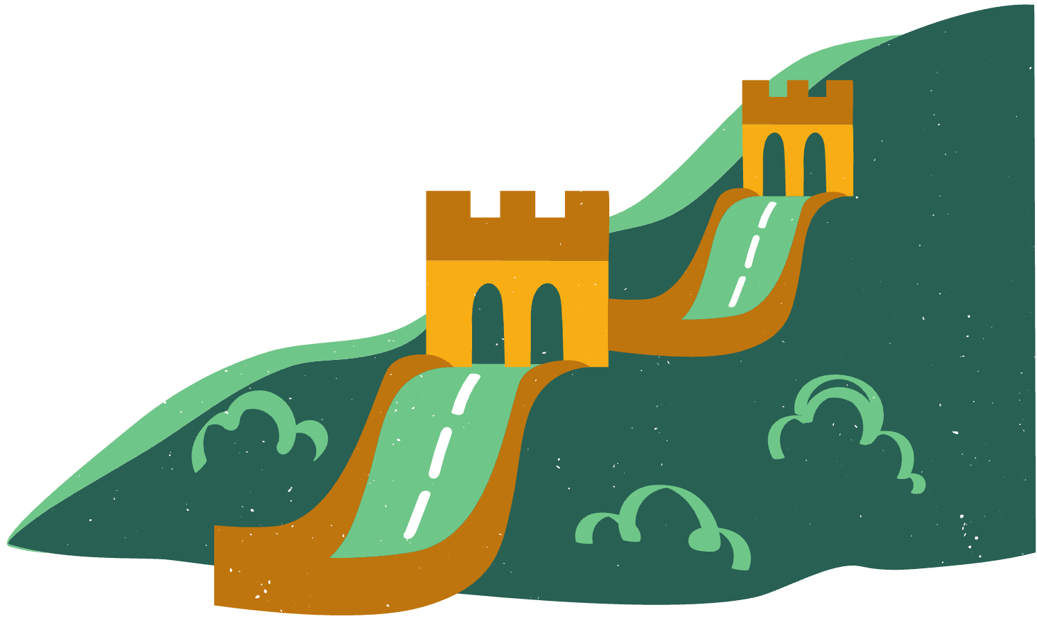
BONUS!

Slide 26
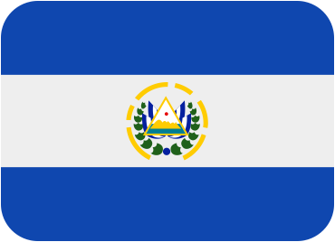
bONUS FLAGS
Can you match each flag with the correct country?
1.
2.
3.
New Zealand
Ireland
Peru
Turkey
El Salvador
Bahamas
4.
5.
6.

Slide 27
FLAGS OF COUNTRIES
ANSWER
Can you match each flag with the correct country?
1.
2.
3.
New Zealand
Ireland
Peru
Turkey
El Salvador
Bahamas
El Salvador
Ireland
Bahamas
4.
5.
6.
Peru
New Zealand
Turkey

Slide 28
TWO OF THE NEW SEVEN WONDERS OF THE WORLD WERE MENTIONED IN THE QUESTIONS!
CAN YOU RECALL THEM BOTH?

Slide 29
TWO OF THE NEW SEVEN WONDERS OF THE WORLD WERE MENTIONED IN THE QUESTIONS!
CAN YOU RECALL THEM BOTH?
ANSWER
THE TAJ MAHAL
EL CASTILLO
(IN THE CITY OF CHICHEN ITZA)

Slide 30
THANKS FOR PLAYING!

Slide 31
CHECK OUT SOME GREAT BOOKS!
A FIRST TIME FOR EVERYTHING
BY DAN SANTAT
ICE CREAM EVERYWHERE: SWEET STORIES FROM AROUND THE WORLD
BY JUDY CAMPBELL-SMITH AND LUCY SEMPLE
HAPPY READING!
HARVEST DAYS: GIVING THANKS AROUND THE WORLD
BY KATE DEPALMA AND MARTINA PELUSO
IF YOU WERE A CITY
BY KYO MACLEAR AND FRANCESCA SANNA
GOOD FOOD, BAD WASTE: LET’S EAT FOR THE PLANET
BY ERIN SILVER AND SUHARU OGAWA

Slide 32
RESOURCE
PAGE
Use these design resources
in your Canva Presentation.
This presentation template
uses the following free fonts:
Titles: Luckiest Guy
Headers: Montserrat
Body copy: Montserrat
You can find these fonts
online too. Happy designing!
Don't forget to delete this
page before presenting.

Slide 34
Sources for these trivia questions include
www.britannica.com
www.thecanadianencylopedia.ca
Photo images courtesy of Adobe Stock Images
Template modified from a free template available courtesy of
Thank you!

